Slide 1
Bank Telemarketing Campaign
Long-term Deposit Subscription Prediction
By: Kyle Calabria

Slide 2
Problem
Based on white paper called ‘A data-driven approach to predict the success of bank telemarketing’ by S. Moro, P. Cortez and P. Rita
Client: Portugese banking Institution
Problem: Predict whether or not the bank’s clients will subscribe to a term-deposit via a telemarketing call

Slide 3
Data
Data
Name | Type | Definition
y | Target (categorical) | Whether or not the client subscribed to the banks long term money deposit (yes or no)
age | Numeric | Age of client
duration | Numeric | Duration of lass phone call with client (Benchmark feature can’t be used in model build)
campaign | Numeric | Number of contacts performed during this campaign
days | Numeric | Number of days that pass after client was last contacted from previous campaign
previous | Numeric | Number of contacts performed to client before current campaign
amp.var.rate | Numeric | Employment variation rate (quarterly indicator)
cons.price.idx | Numeric | Consumer price index (monthly indicator)
cons.conf.idx | Numeric | Consumer confidence index (monthly indicator)
euribor3m | Numeric | Euribor 3 month rate (daily indicator)
nr.employed | Numeric | Number of employees (quarterly indicator)
job | Categorical | Job of client
marital | Categorical | Marital status
education | Categorical | Education level of client
default | Categorical | Whether client has currently in default on a loan
housing | Categorical | Whether the client has a housing loan
loan | Categorical | Whether the client has a general loan
contact | Categorical | Whether client’s phone was a cell or home
month | Categorical | Month of last contact made to client
day_of_week | Categorical | Day of week last contact was made to client
poutcome | Categorical | Outcome of previous campaign
Dataset: twenty-one features and 41,188 samples
No missing data to handle
Hot one encoded all categorical features
Converted target variable to binary representation
Left all numeric features raw

Slide 4
Exploratory Data Analysis

Slide 5
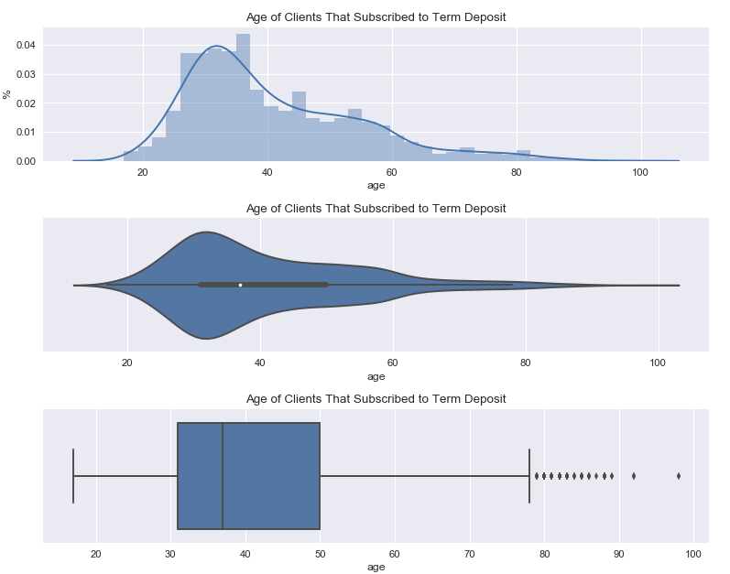
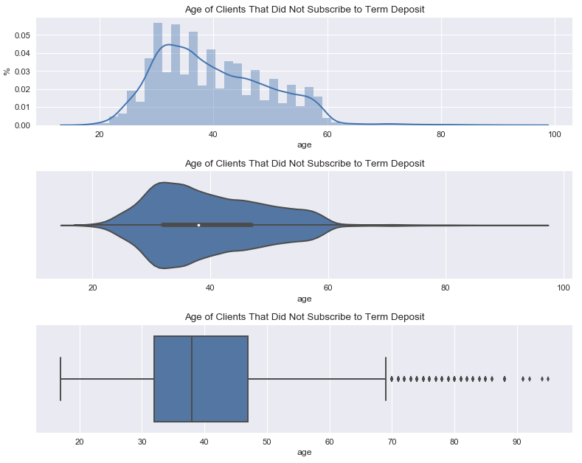
Age

Slide 6
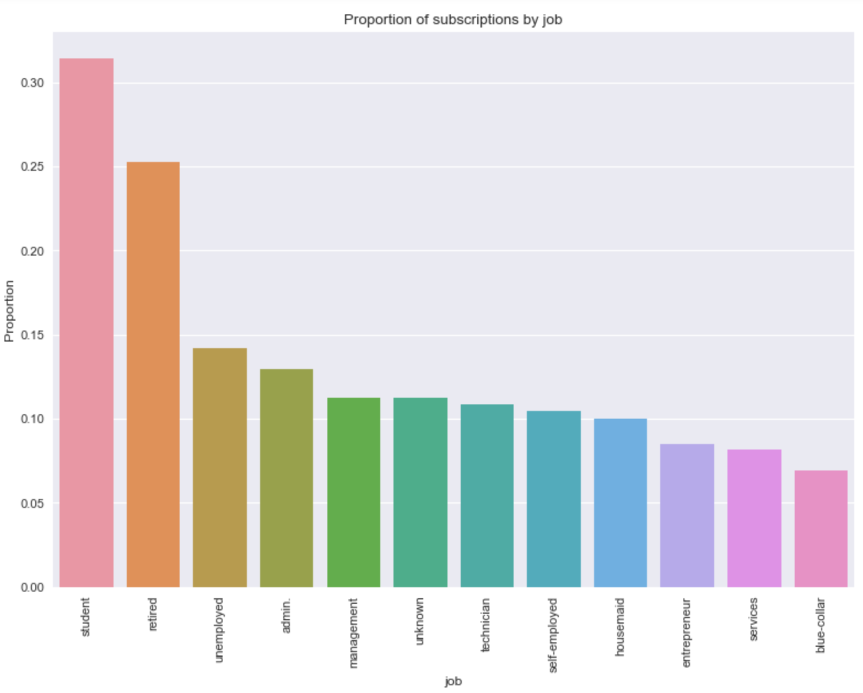
Job

Slide 7
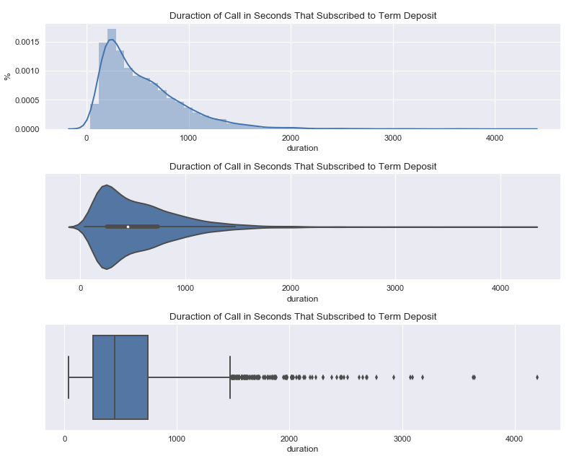
Call Duration

Slide 8
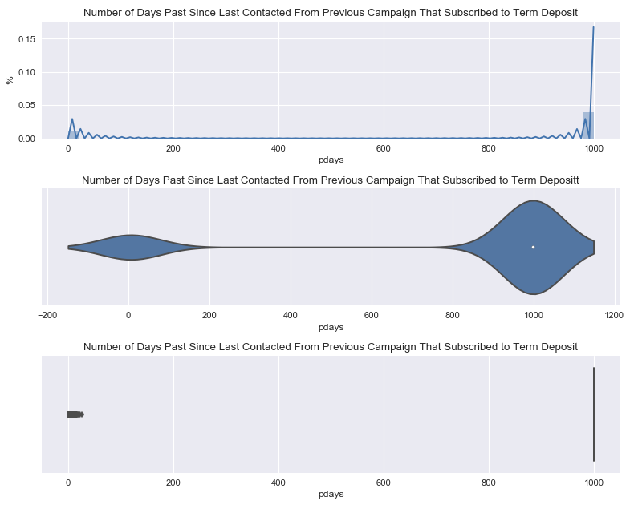
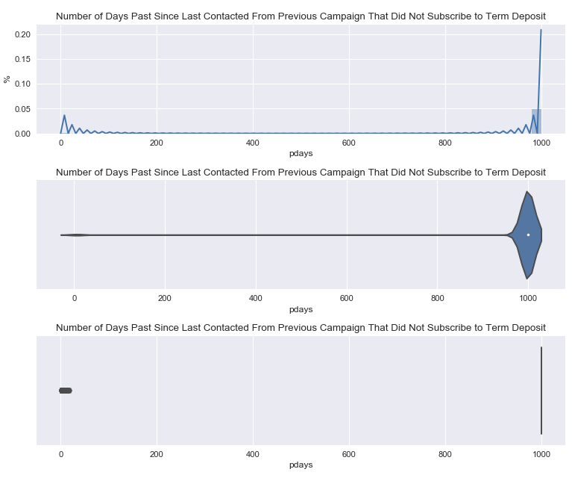
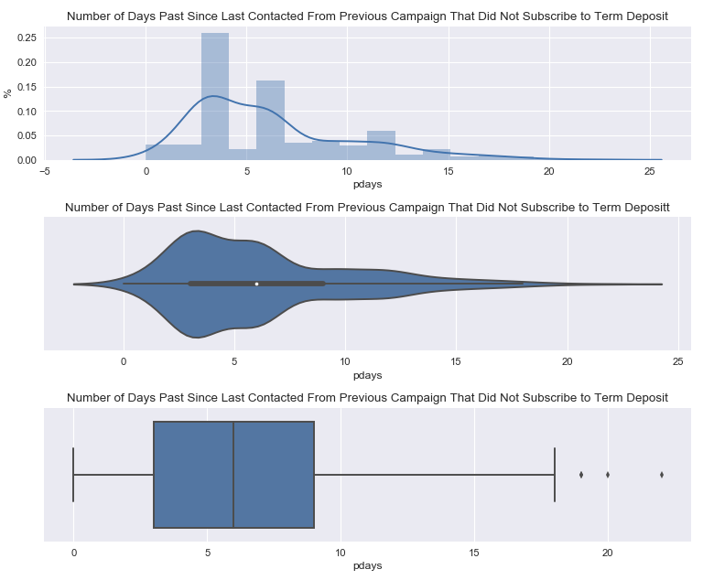
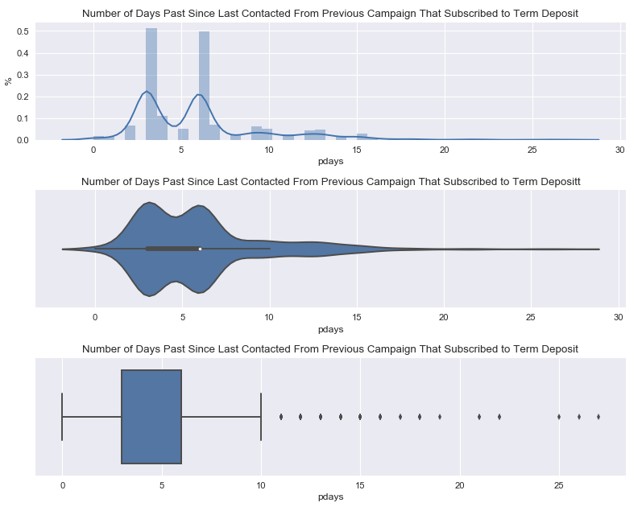
Days since last contact from previous campaign

Slide 9
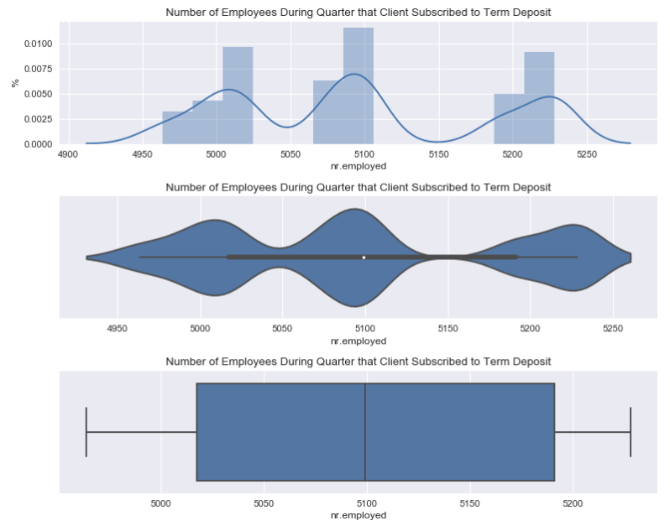
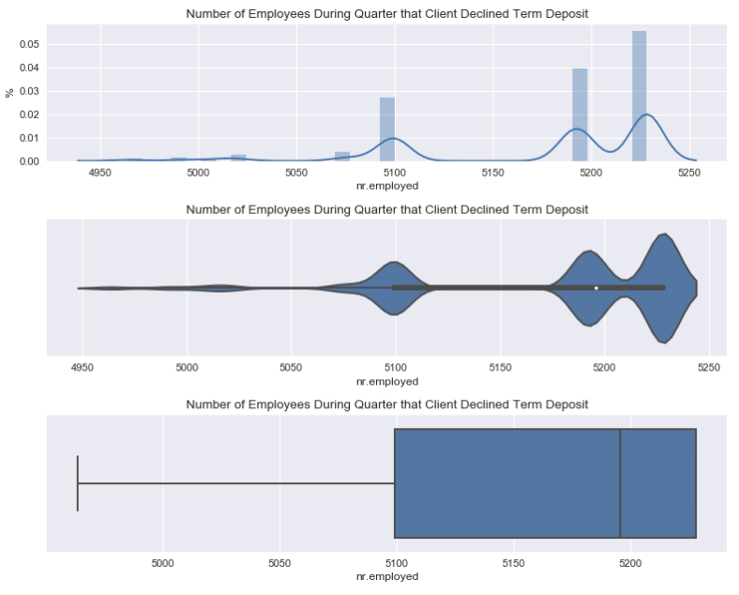
Number of Employees

Slide 10
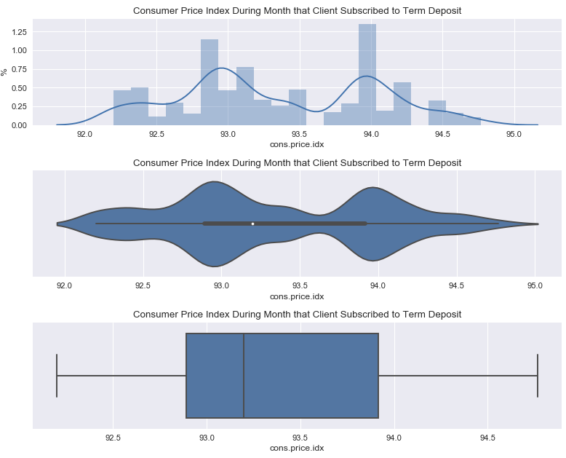
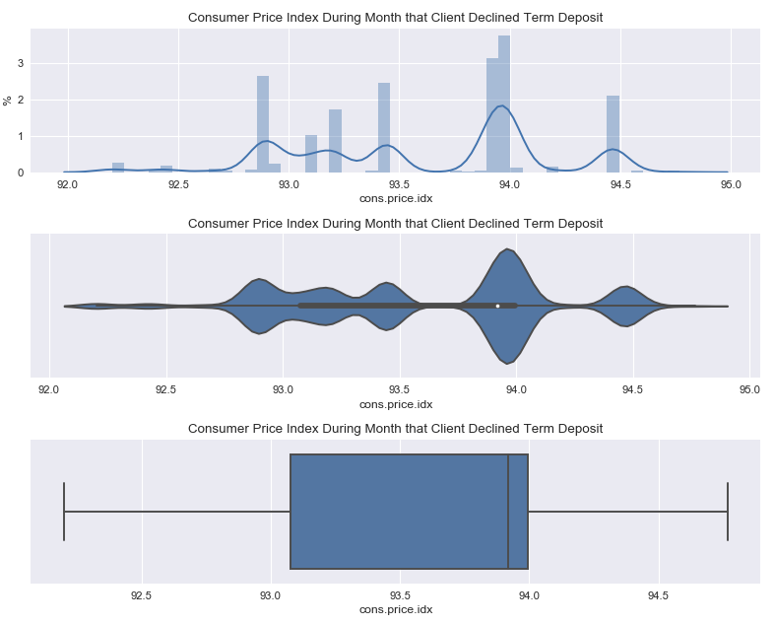
Consumer Price Index

Slide 11
Feature Engineering
Custom binning by proportion of positive responses category: age, job, education, month of last contact, number of contacts performed during current campaign, number of days passed since last contact, and number of contacts performed before this campaign
Proportion feature or positive responses by age, education, marital status and job

Slide 12
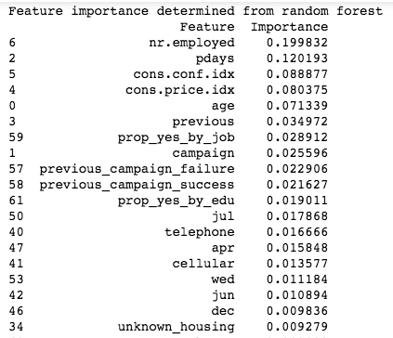
Feature Importance

Slide 13
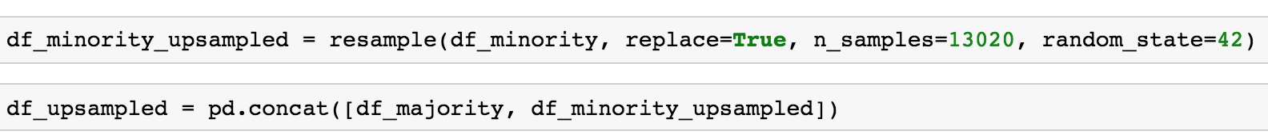
Performance Metrics & Balancing
Receiver Operating Characteristic vs Precision-Recall vs Accuracy
11.27% positive minority class
Upsampling technique:

Slide 14
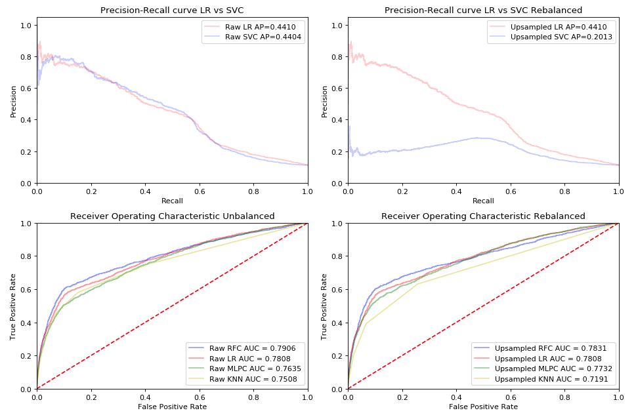
Modeling

Slide 15
Recommendations
Timing campaigns based on social and economic indicators
Prioritizing calls by setting a probability of conversion threshold using probability estimates produced by Random Forest Classifier
Consider precision-recall curve analysis to reduce customer disturbance and marketing costs

